Slide 1

EE5159 - Device Simulation & Characterization Laboratory
Under the guidance of:
Dr. Kaushik Nayak and Dr. Naresh Emani,
Department of Electrical Engineering
Presented by:
Tarun Tej Reddy - EE17BTECH11042
Karthik Pagadala - EE17BTECH11049

Slide 2
Section - I
Device Simulation

Slide 3
Table of Contents
Introduction
Schrödinger equation and Particle in a Potential Well
Quantum Tunneling and Working of FGMOS
Sentaurus Structure Editor (sde)
Sprocess
Sdevice

Slide 4
1. Introduction
In this part of the course, the device we simulated is a Floating Gate Metal Oxide Semiconductor Capacitor and Field Effect Transistor.
We have used two tools from the TCAD library: Sentaurus Structure Editor and Sdevice.
We have also studied Schrödinger Equation and Wave Functions and how they are applied in Particle in a Potential Well to understand tunneling.

Slide 5
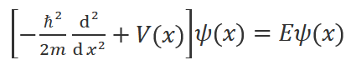
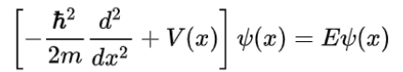
2. Schrödinger equation and Particle in a Potential Well
The Schrödinger equation is a partial differential equation that describes the wave function of a quantum-mechanical system
It is analogous to Newton’s second law of motion.
The Schrödinger equation can be used to find the wave function of a particle in a finite/infinite Potential Well.
The square of absolute value of the wave function gives the probability density that a particle will be found at that position x.
The time independent Schrödinger equation is given by:
Notes:
Read about wave function. Have to read more detail about wave function square
Second law of motion- to find position and velocity of a macro object. Schrodinger equation gives wave function which describes the dynamics of the particle
Explain conservation of energy for the last point.

Slide 6
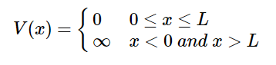
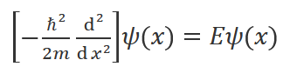
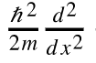
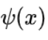
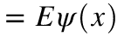
Particle in a Infinite Potential Well
For an Infinite Potential Well,
Therefore, the Schrödinger equation reduces to,

Slide 7
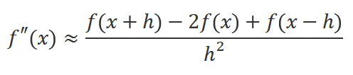
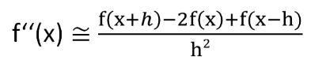
Finite Difference method
FDM is an approximate method for solving differential equations.
This method converts a differential equation into a difference equation, which can be solved by programming.
Using the first principles of differentiation or Taylor series expansion, we obtain:
Notes:
We can tell this is used everywhere in TCAD to solve poisson and continuity equations

Slide 8
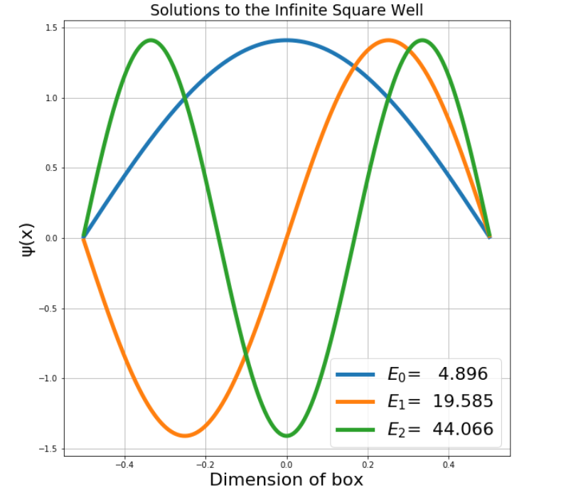
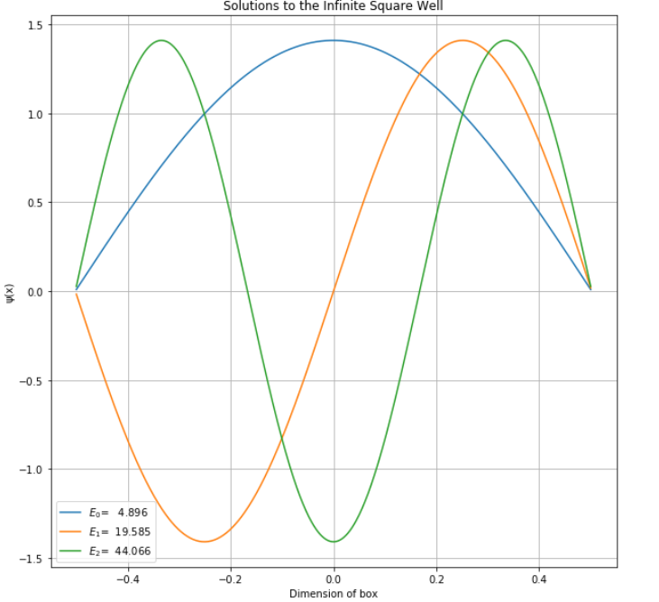
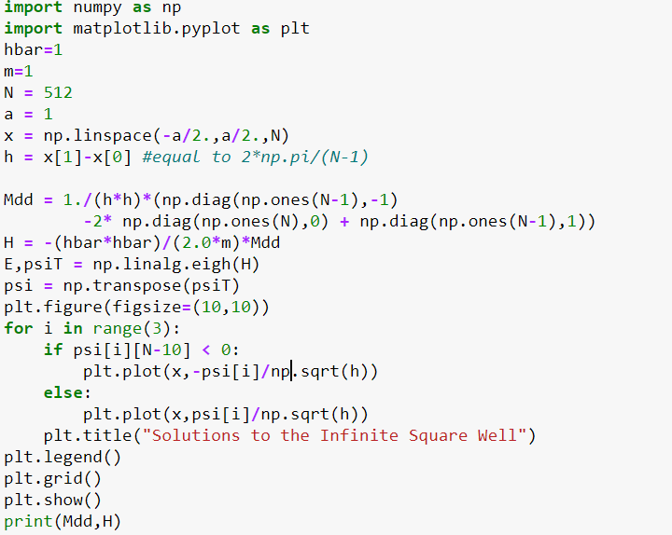
Particle in a Infinite Potential Well

Slide 9
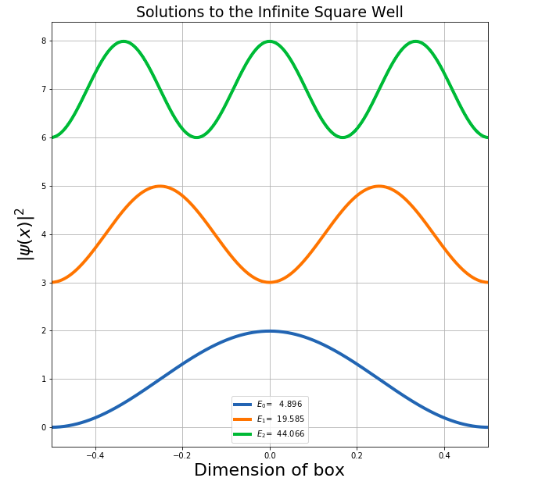
|ψ|² Plot for a particle in Infinite Well
This is the plot of |ψ(x)|². It gives the probability of finding the particle at a particular point. The area of |ψ(x)|² for any energy level is 0.9869, that is, the total probability of finding an electron is 1.

Slide 10
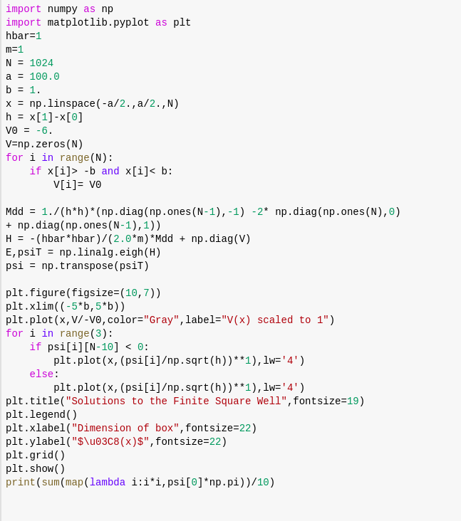
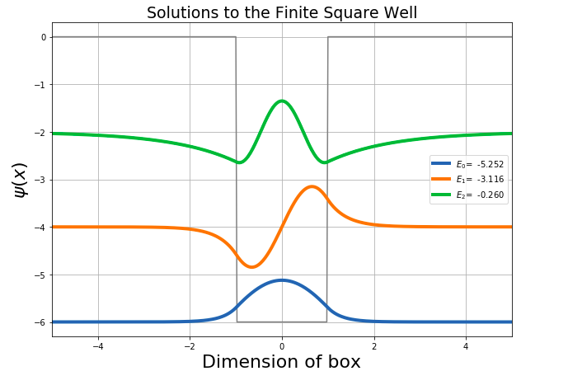
Particle in a Finite Potential Well
Notes:
Bound states, if energy is less than potential, particle is bounded. Scattering state, energy is greater than potential, then the particle is free and can
In a bound state, the energy will be quantized, that is, only multiples of a certain quantity of energy will be allowed.
Penetration depth is directly proportional to α^2 =hbar^2/ 2m(V0−E) > 0

Slide 11
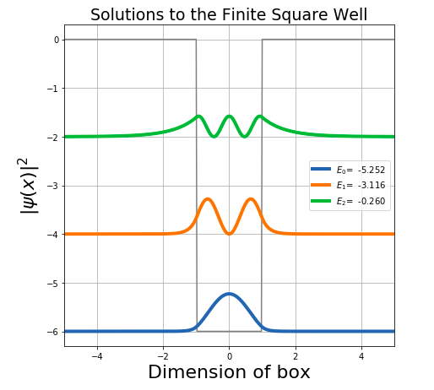
|ψ|² Plot for a Particle in Finite Well
The plot of |ψ(x)|² is as follows.
The area of |ψ(x)|² for any energy level is 0.9869 ,that is, the total probability of finding an electron is 1.

Slide 12
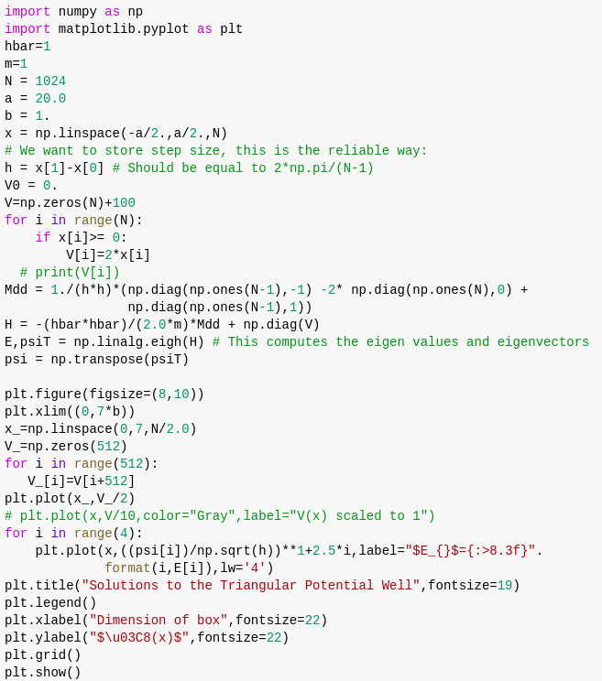
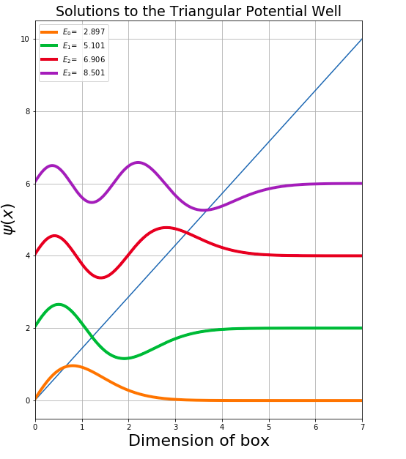
Triangular Potential Well
Notes:
AIRY functions : y″−xy=0
Also explain tunneling

Slide 13
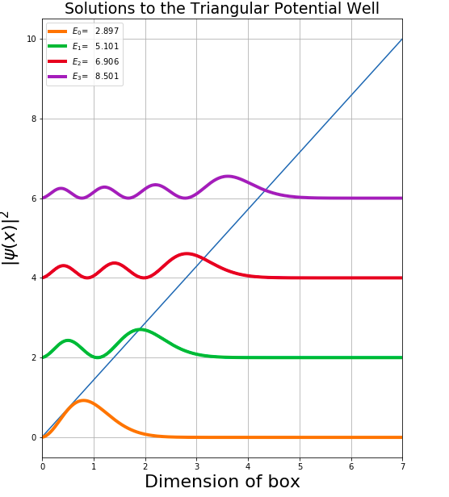
|ψ|² Plot for a Particle in Triangular Well
This is the plot of |ψ(x)|². It gives the probability of finding the particle at a particular point. The area of |ψ(x)|² for any energy level is 0.991, that is, the total probability of finding an electron is 1.

Slide 14
3. Quantum Tunneling and Working of FGMOS
According to classical physics, it is physically impossible for a particle to cross a potential barrier when the barrier height is greater than the energy of the particle.
However, in the quantum world, the wave nature of particles becomes more prominent.
With the advent of the Uncertainty Principle, particles could no longer be said to have separate, well-defined positions and velocities, but only a “quantum state”, a combination of position and velocity.
If it is not possible to know the values of all of the properties of the system at the same time, then the properties that are not known with precision must be described by probabilities.

Slide 15
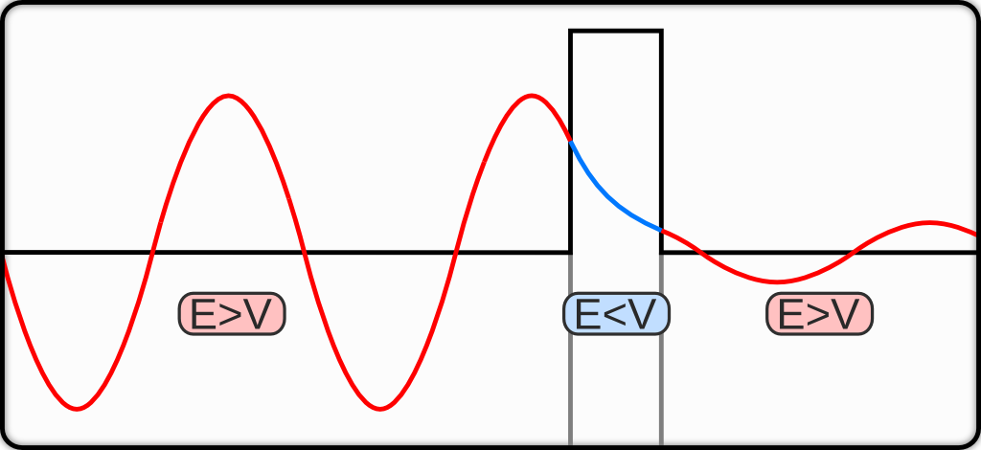
Quantum Tunneling
Wavefunction gives a complete description of the quantum state of particle.
Notes:
Talk about wave function, probabilities on left and right side of the barrier. If barrier is thin enough, then tunneling easy.
Quantum state -

Slide 16
Tunneling in Nature
In nature, tunneling occurs in several interesting phenomenon:
The temperature in stars' cores is generally insufficient to allow atomic nuclei to overcome the Coulomb barrier and achieve Thermonuclear fusion. Quantum tunneling increases the probability of penetrating this barrier.
The first application of Quantum tunneling was radioactive decay.
Electron tunnelling is a key factor in many biochemical redox reactions (photosynthesis, cellular respiration) as well as enzymatic catalysis while proton tunnelling is a key factor in spontaneous mutation of DNA.

Slide 17
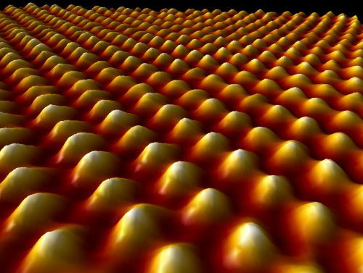
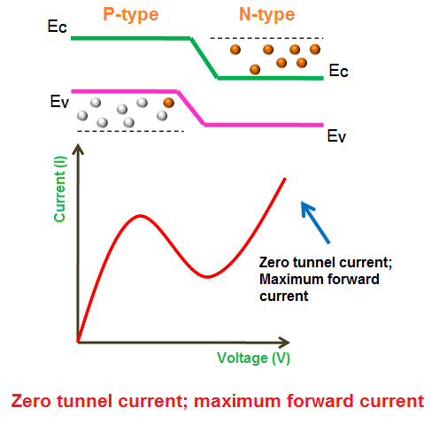
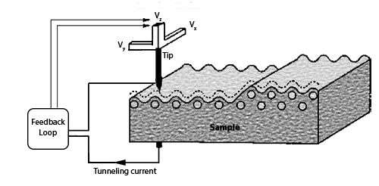
Applications of Tunneling
Josephson Junctions
Tunnel Diode
Scanning Tunneling Microscope (STM)
Flash Memory
https://www.nanoscience.com/techniques/scanning-tunneling-microscopy/

Slide 18
Working of FGMOS
Hot Carrier Injection
Hot carrier injection is a phenomenon where an electron or a “hole” gains sufficient kinetic energy to overcome a potential barrier.
In a FGMOS, electrons acquire sufficient energy to become 'HOT' and traverse through the first oxide insulator, so that they get trapped on the floating gate.
To enter the conduction band of SiO2, an electron must gain a kinetic energy of ~3.2 eV.
Fowler–Nordheim tunneling
Notes:
Hot Carrier Degradation is one of the factors that cause the number of write-erase cycles to be limited

Slide 19
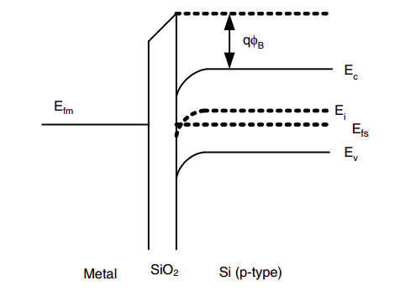
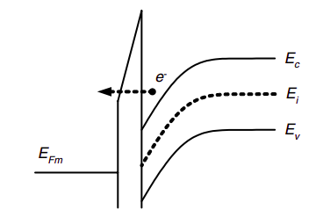
Fowler-Nordheim tunneling in MOS devices
For oxide lengths in the range 10-100 nm.
The electrons do not tunnel directly to the other side of the barrier. Instead they tunnel from the silicon inversion layer to the conduction band of the oxide layer from where they are transported to the gate contact
Notes:
When a large positive voltage is applied to the metal with respect to the substrate, the left-hand side of the band diagram is lowered, and tunneling of electrons from the conduction band of the semiconductor into the conduction band of the oxide.
At Fowler-Nordheim conditions the electron tunnels through a part of the barrier to the conduction band of the SiO2. From there it can flow to the anode

Slide 20
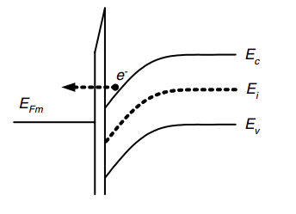
Direct tunneling in MOS devices
When the oxides have thicknesses in the order of a few nanometers the barrier is not triangular.
The electrons from the inverted silicon surface can tunnel directly through the forbidden energy barrier formed by the dielectric layer to the poly-gate.
Notes:
At direct tunneling conditions the electron tunnels through the whole oxide energy barrier

Slide 21
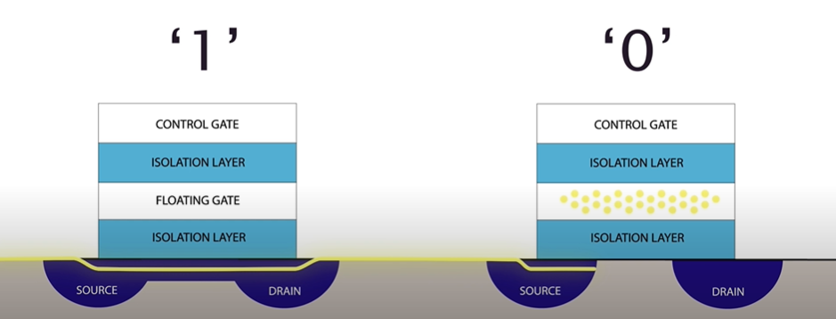
Charging and Discharging an FGMOS
The working of flash memory is based on the electrons in the floating gate.
When electrons are present on the floating gate, current can't flow through the transistor and the bit state is 0. This is the normal state for a floating gate transistor, when a bit is programmed.
When electrons are removed from the floating gate, current is allowed to flow and the bit state is 1.
Notes:
If the floating gate is not charged (i.e. neutral), then the device operates almost like a normal MOSFET, a positive charge in the control gate creates a channel in the p-substrate that carries a current from source to drain. If however the floating gate is negatively charged, then this charge shields the channel region somewhat from the control gate and prevents the formation of a channel between source and drain. The threshold voltage is the voltage applied to the control gate at which a transistor becomes conductive. The presence or the absence of a charge results in a more positive or more negative threshold voltage. In flash memory lingo, programming (putting electrons into the floating gate) means writing a 0, erasing (removing the charge from the floating gate) means resetting the flash memory contents to 1; or in other words: a programmed cell stores a logic 0, an erased (a.k.a. flashed) cell stores a logic 1.

Slide 22
4. Sentaurus Structure Editor
It is a structure editor for creating 2D and 3D device models geometrically.
Geometries can be created using both the GUI and the command-line. Every action done using GUI has an equivalent script command, which is printed when the GUI is used.
After defining the geometry, various materials (and their concentrations) can be assigned to different sections of the geometry. 1D, 2D or 3D analytical doping profiles can be used to finetune the doping as per requirements.

Slide 23
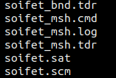
Sentaurus Structure Editor - Simulations
In the process of learning this tool, we generated the structure of SOIFET and doped it.
SDE gave the following output files for the SOIFET:
.scm is the Scheme Script File
.sat is the ACIS SAT file
_bnd.tdr is the TDR boundary file
_msh.cmd is the doping and refinement file
_msh.log
_msh.tdr
Files generated in simulation
Cited on 20-07-2020 on “http://www.sentaurus.dsod.pl/sse/sse_a.html”
Notes:
Scm file: This is a user-defined script file that contains Scheme script commands describing the steps to be executed by Sentaurus Structure Editor when creating a device structure. This file can be edited.
Sat file: This file contains the model geometry in native ACIS format and cannot be edited directly.
Bnd.tdr: This is a boundary representation file written in TDR file format.
Msh.log: contains the Sentaurus Mesh output protocol, which includes some information about meshing steps and mesh statistics.
Msh.tdr: output tdr file with mesh info
Msh.cmd: a command file (.cmd) . This and bnd.tdr are inputs for meshing. Msh.tdr and msh.log are output.

Slide 24
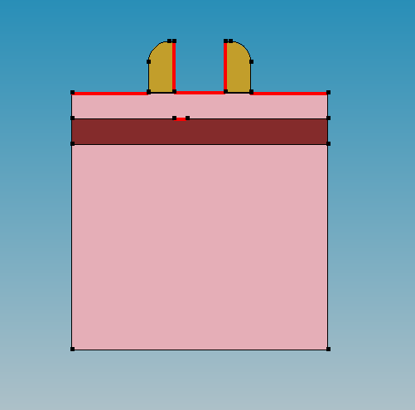
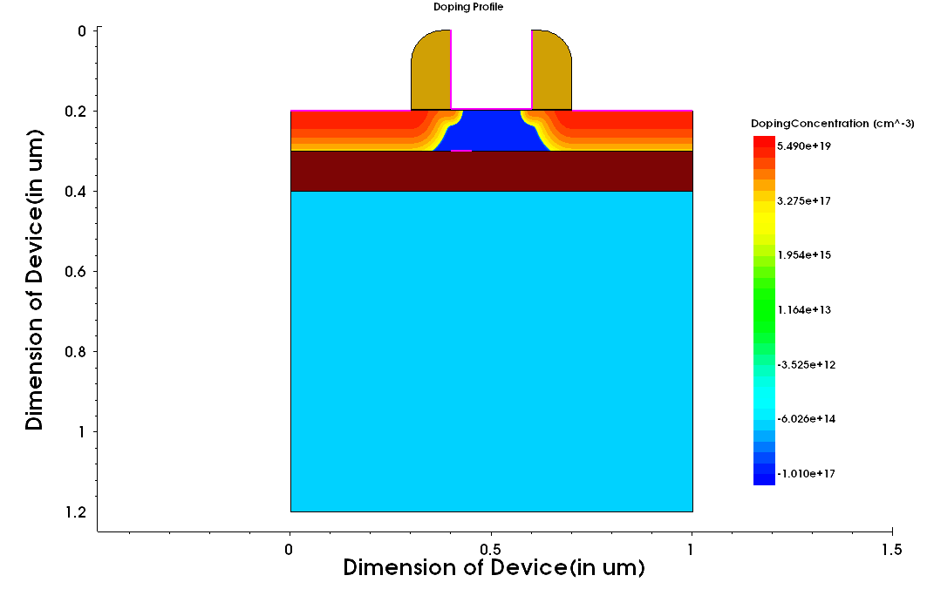
SOIFET
Geometry
Doping
Notes:
Reduced parasitic capacitance

Slide 25
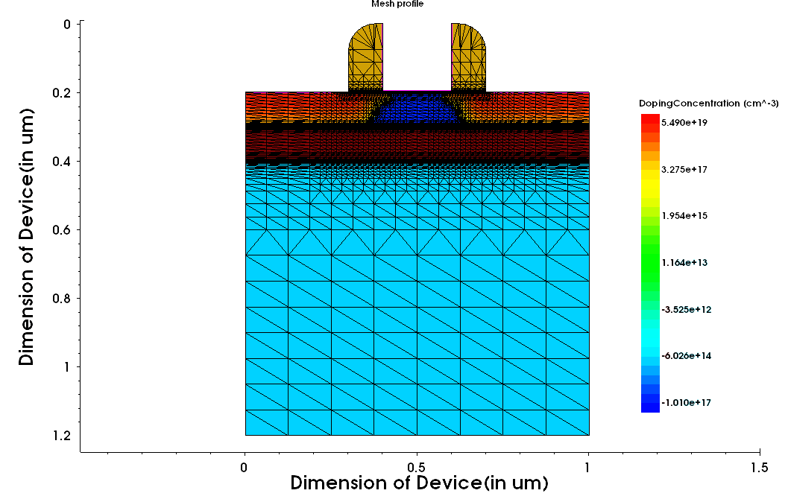
Meshing

Slide 26
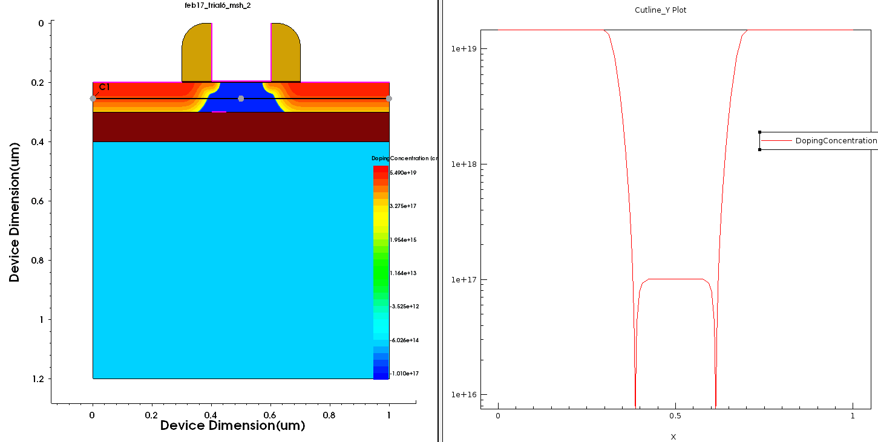
Cutline

Slide 27
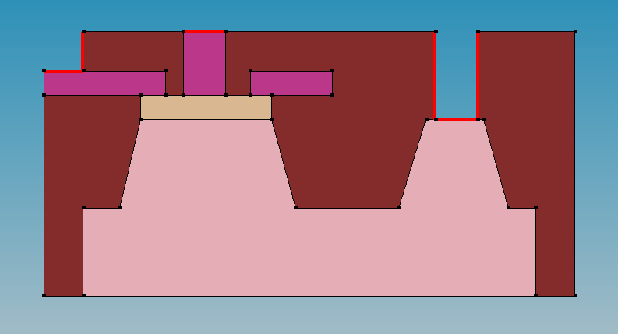
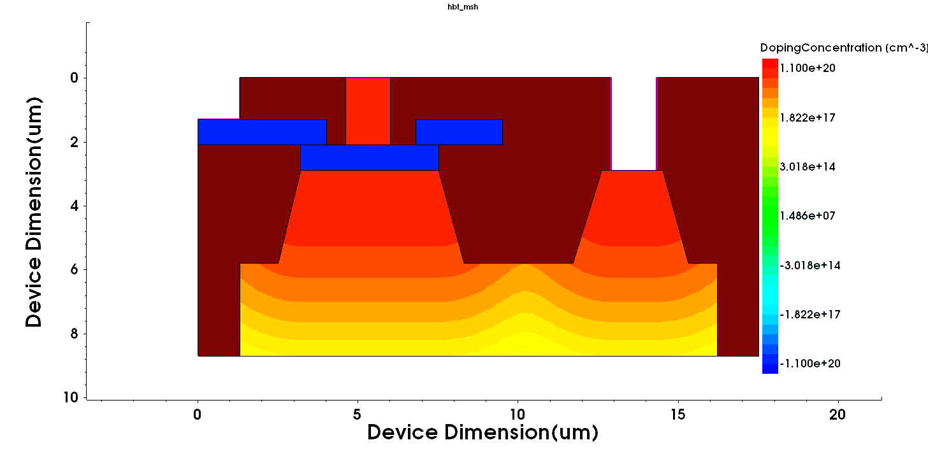
HBT
Doping
Geometry

Slide 28
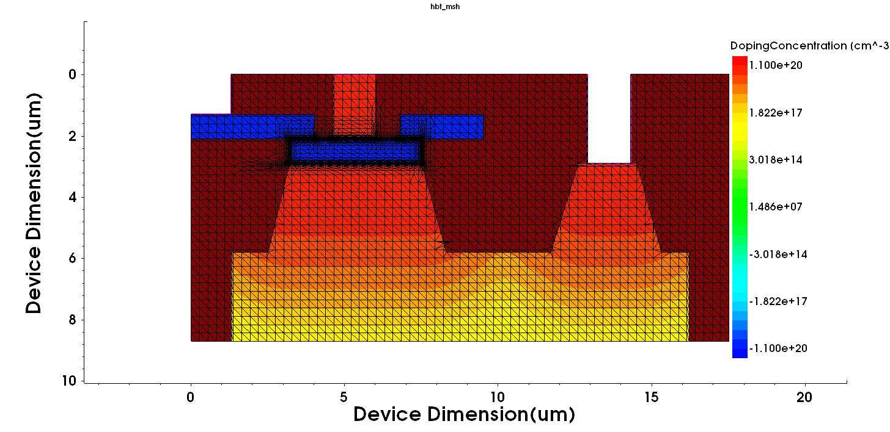
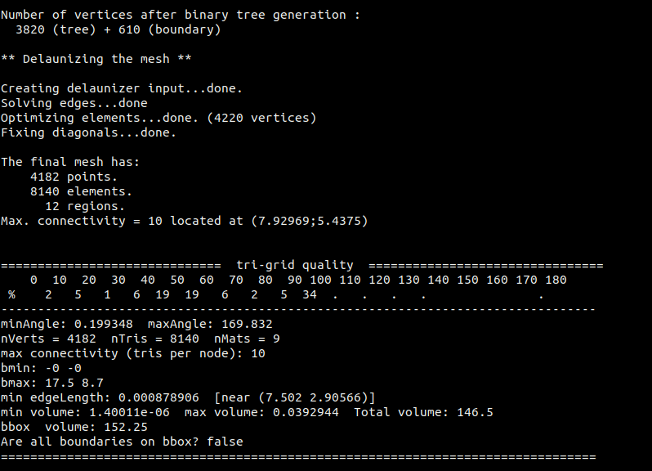
Mesh Information
Meshing

Slide 29
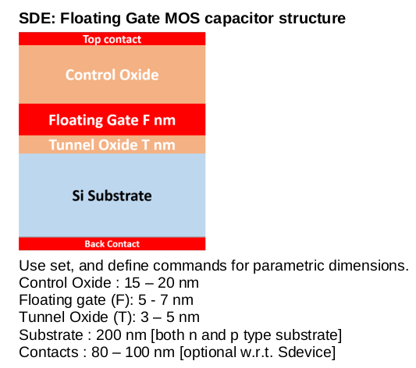
Problem Statement - FGMOSCAP

Slide 30

Creating Geometry and Doping
(sde:clear) (sdegeo:set-default-boolean "ABA") (define t_cont_up 0.080) (define t_co 0.015) (define t_fg 0.005) (define t_to 0.003) (define t_sub 0.2) (define t_cont_down 0.080) (define width 0.3) (define x0 0) (define x1 width) (define y0 0) (define y1 (+ y0 t_cont_up)) (define y2 (+ y1 t_co)) (define y3 (+ y2 t_fg)) (define y4 (+ y3 t_to)) (define y5 (+ y4 t_sub)) (define y6 (+ y5 t_cont_down)) (define z0 0) (sdegeo:create-rectangle (position x0 y0 z0) (position x1 y1 z0) "PolySilicon" "Top_Contact") (sdegeo:create-rectangle (position x0 y1 z0) (position x1 y2 z0) "Oxide" "Control Oxide") (sdegeo:create-rectangle (position x0 y2 z0) (position x1 y3 z0) "Metal" "Floating Gate") (sdegeo:create-rectangle (position x0 y3 z0) (position x1 y4 z0) "Oxide" "Tunnel Oxide") (sdegeo:create-rectangle (position x0 y4 z0) (position x1 y5 z0) "Silicon" "Substrate") (sdegeo:create-rectangle (position x0 y5 z0) (position x1 y6 z0) "PolySilicon" "Back_Contact") (sdegeo:set-contact (find-body-id (position (+ x0 0.001) (+ y0 0.001) z0)) "Top Contact") (sdegeo:set-contact (find-body-id (position (+ x0 0.001) (+ y5 0.001) z0)) "Back Contact")
(sdedr:define-constant-profile "Const.Ptype" "BoronActiveConcentration" 1e17) (sdedr:define-constant-profile-region "PlaceCD.bulk_p" "Const.Ptype" "Substrate")

Slide 31
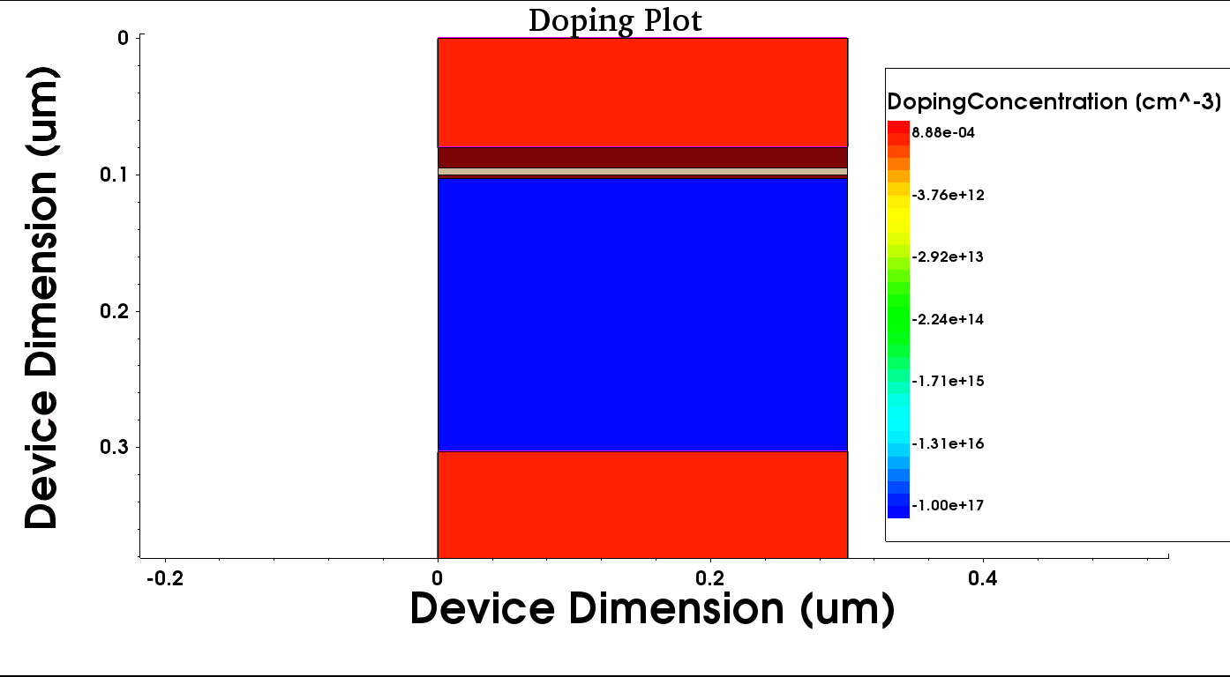

Slide 32
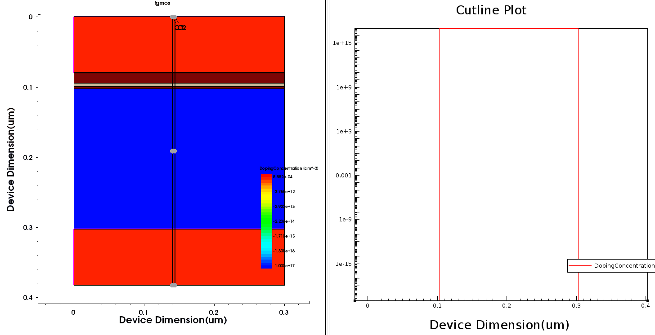

Slide 33
Meshing
(sdedr:define-refeval-window "RefWin.all" "Rectangle" (position (- x0 0.05) (- y0 0.05) z0) (position (+ x1 0.05) (+ y6 0.05) z0)) (sdedr:define-refinement-size "RefinementDefinition_1" 0.015 0.015 0.001 0.001 ) (sdedr:define-refinement-placement "RefinementPlacement_1" "RefinementDefinition_1" (list "window" "RefWin.all" ) ) (sdedr:define-refinement-function "RefinementDefinition_1" "MaxLenInt" "Tunnel Oxide" "Substrate" 0.0001 1.1 "UseRegionNames") (sdedr:define-refinement-function "RefinementDefinition_1" "MaxLenInt" "Tunnel Oxide" "Floating Gate" 0.0005 2.5 "DoubleSide" "UseRegionNames") (sdedr:define-refinement-function "RefinementDefinition_1" "MaxLenInt" "Floating Gate" "Control Oxide" 0.0005 1.5 "DoubleSide" "UseRegionNames") (sdedr:define-refinement-size "RefinementDefinition_cont_ox" 0.005 0.005 0.001 0.001 ) (sdedr:define-refinement-placement "RefinementPlacement_Ox" "RefinementDefinition_cont_ox" (list "region" "Control Oxide" ) ) (sdedr:define-refinement-size "RefinementDefinition_tunn_ox" 0.0015 0.0015 0.0001 0.0001 ) (sdedr:define-refinement-placement "RefinementPlacement_tunn_Ox" “RefinementDefinition_tunn_ox" (list "region" "Tunnel Oxide" ) ) (sdedr:define-refinement-size "RefinementDefinition_metal" 0.005 0.005 0.0001 0.0001 ) (sdedr:define-refinement-placement "RefinementPlacement_metal" "RefinementDefinition_metal" (list "material" "Metal" ) )

Slide 34
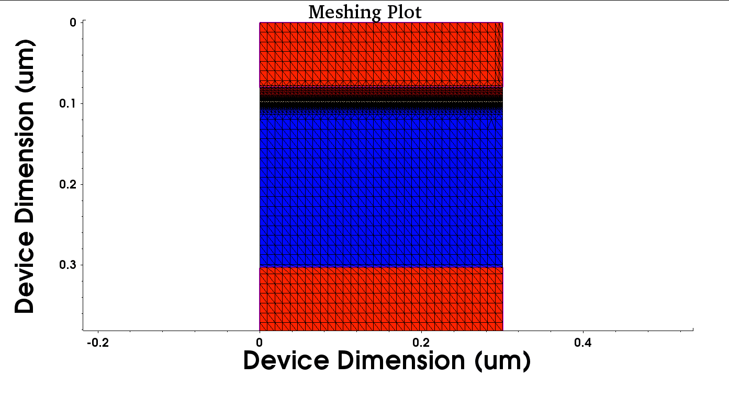
FGMOSCAP mesh

Slide 35
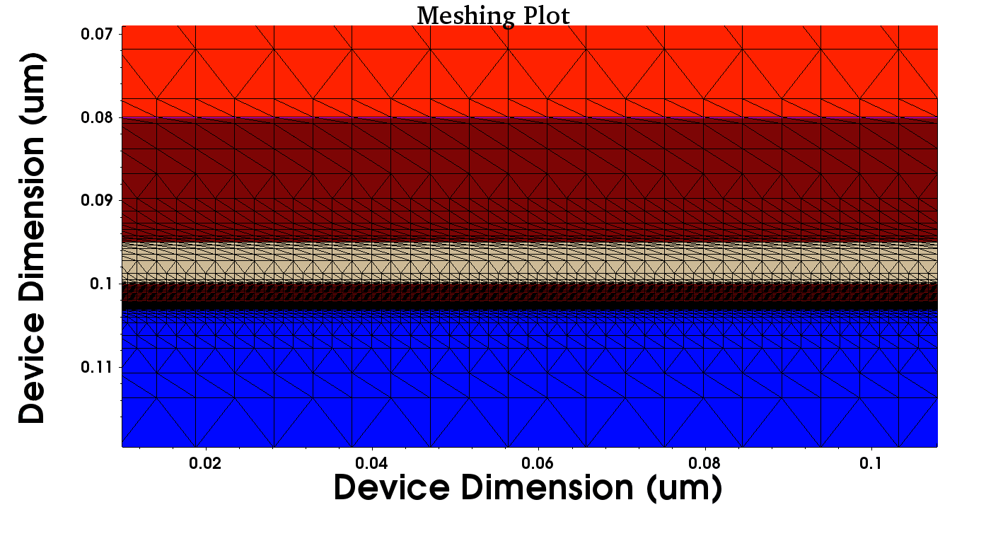

Slide 36
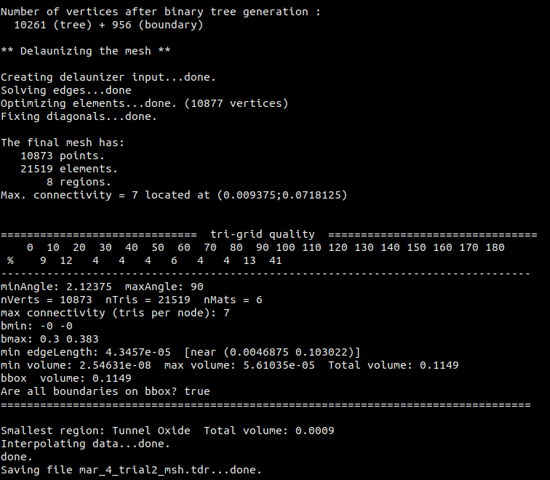
Mesh Information
Total tree vertices = 10261
Total boundary vertices = 956
Final Mesh:
10873 points
21519 elements
8 regions

Slide 37
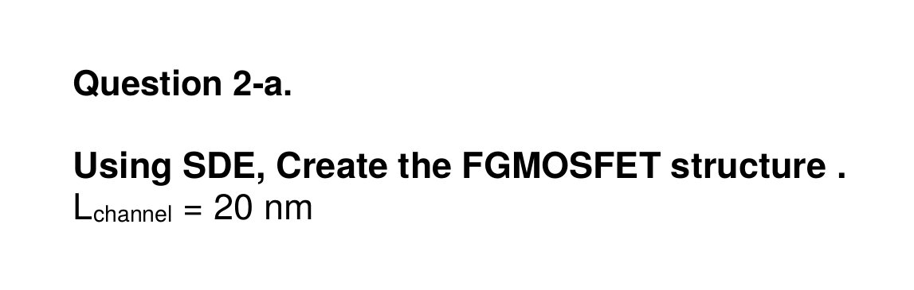
Problem Statement - FGMOSFET

Slide 38
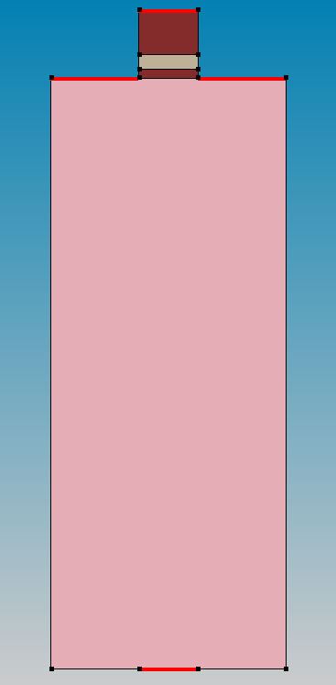
Creating Geometry and Doping
(sde:clear) (sdegeo:set-default-boolean "ABA") (define t_cont_up 0.080) (define t_co 0.015) (define t_fg 0.005) (define t_to 0.003) (define t_sub 0.2) (define t_cont_down 0.080) (define width 0.020) (define x0 0) (define x1 width) (define xleft (- x0 0.03)) (define xright(+ x1 0.03)) (define y0 0) (define y1 (+ y0 t_cont_up)) (define y2 (+ y1 t_co)) (define y3 (+ y2 t_fg)) (define y4 (+ y3 t_to)) (define y5 (+ y4 t_sub)) (define y6 (+ y5 t_cont_down)) (define z0 0)
(sdegeo:create-rectangle (position x0 y0 z0) (position x1 y1 z0) "PolySilicon" "Top_Contact") (sdegeo:create-rectangle (position x0 y1 z0) (position x1 y2 z0) "Oxide" "Control_Oxide") (sdegeo:create-rectangle (position x0 y2 z0) (position x1 y3 z0) "Metal" "Floating_Gate") (sdegeo:create-rectangle (position x0 y3 z0) (position x1 y4 z0) "Oxide" "Tunnel_Oxide") (sdegeo:create-rectangle (position xleft y4 z0) (position xright y5 z0) "Silicon" "Substrate") (sdegeo:create-rectangle (position x0 y5 z0) (position x1 y6 z0) "PolySilicon" "Back_Contact") (sdegeo:set-contact (find-body-id (position (+ x0 0.001) (+ y0 0.001) z0)) "Top_ct_Contact" "remove") (sdegeo:set-contact (find-body-id (position (+ x0 0.001) (+ y5 0.001) z0)) "Back_ct_Contact" "remove") (sdegeo:set-contact (find-edge-id (position (+ xleft 0.005) y4 0.0)) "source") (sdegeo:set-contact (find-edge-id (position (+ x1 0.005) y4 0.0)) "drain")

Slide 39
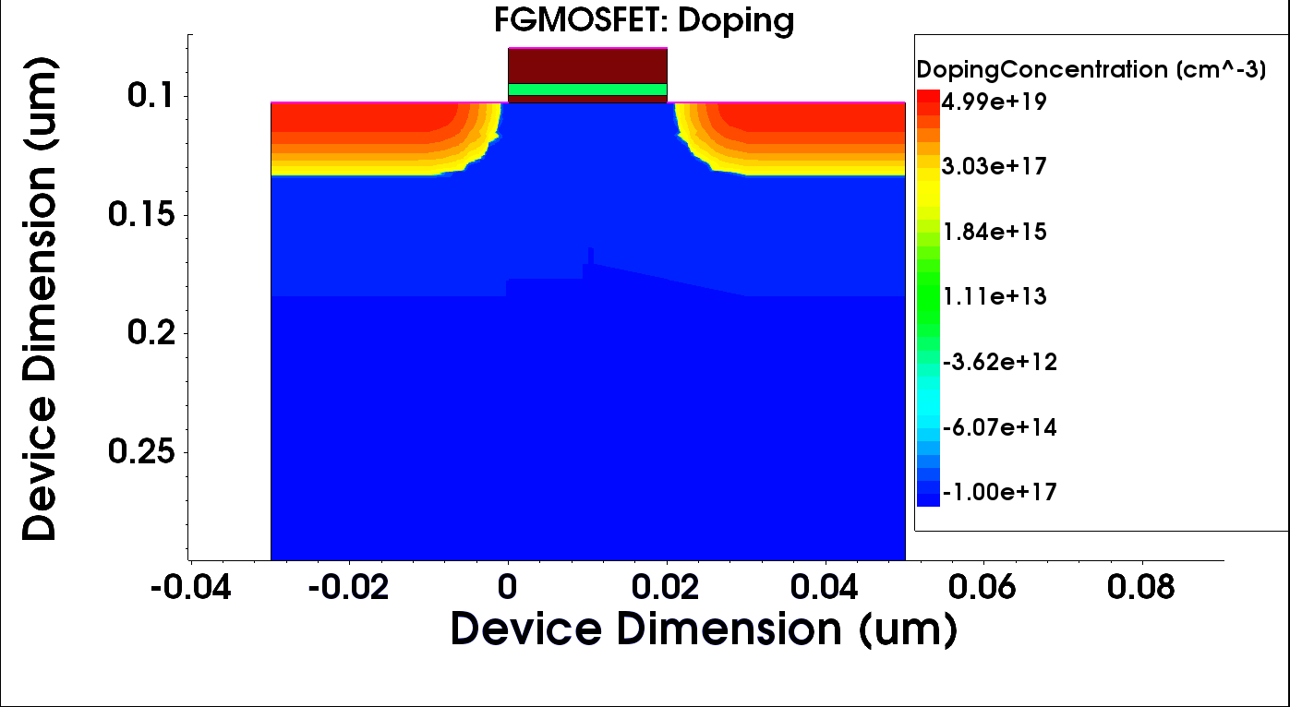
Doping
(sdedr:define-constant-profile "Const.Ptype" "BoronActiveConcentration" 1e17) (sdedr:define-constant-profile-region "PlaceCD.bulk_p" "Const.Ptype" "Substrate")
(sdedr:define-refeval-window "BaseLine.Source" "Line" (position xleft y4 z0) (position (- x0 0.01) y4 z0)) (sdedr:define-refeval-window "BaseLine.Drain" "Line" (position (+ x1 0.01) y4 z0) (position xright y4 z0))
(sdedr:define-analytical-profile-placement "PlaceAP.Source" "Gauss.SourceDrain" "BaseLine.Source" "Positive" "NoReplace" "Eval")
(sdedr:define-gaussian-profile "Gauss.SourceDrain" "ArsenicActiveConcentration" "PeakPos" 0 "PeakVal" 5e+19 "ValueAtDepth" 1e+17 "Depth" 0.03 "Gauss" "Factor" 0.3)
(sdedr:define-analytical-profile-placement "PlaceAP.Drain" "Gauss.SourceDrain" "BaseLine.Drain" "Positive" "NoReplace" "Eval")
(sdedr:define-gaussian-profile "Gauss.SourceDrain" "ArsenicActiveConcentration" "PeakPos" 0 "PeakVal" 5e+19 "ValueAtDepth" 1e+17 "Depth" 0.03 "Gauss" "Factor" 0.3)

Slide 40
Notes:
Put dimensions

Slide 41
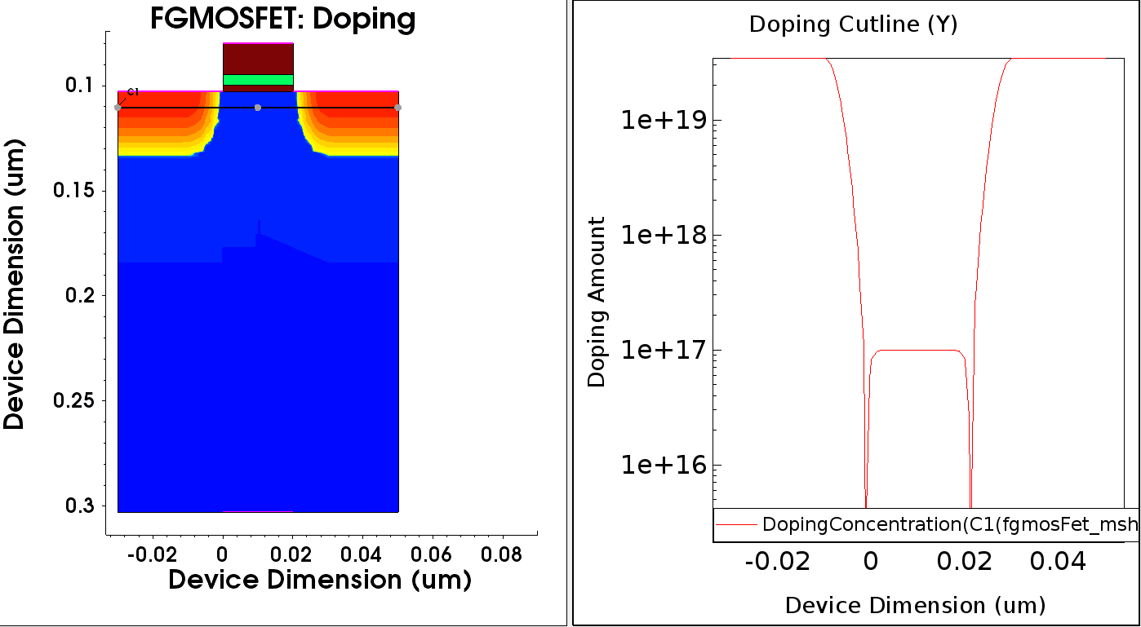

Slide 42
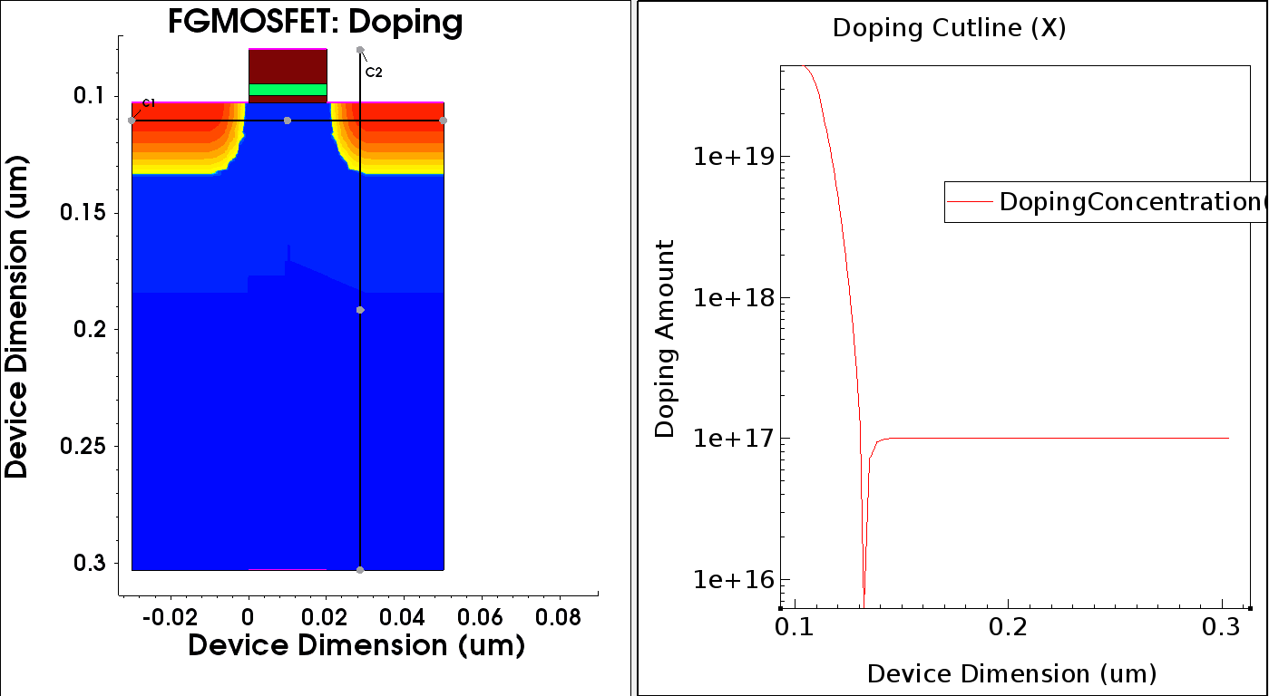

Slide 43
Meshing
(sdedr:define-refeval-window "RefWin.all" "Rectangle" (position (- x0 0.05) (- y0 0.05) z0) (position (+ x1 0.05) (+ y6 0.05) z0)) (sdedr:define-refinement-size "RefinementDefinition_1" 0.015 0.015 0.001 0.001 ) (sdedr:define-refinement-placement "RefinementPlacement_1" "RefinementDefinition_1" (list "window" "RefWin.all" ) ) (sdedr:define-refinement-function "RefinementDefinition_1" "MaxLenInt" "Tunnel_Oxide" "Substrate" 0.0001 1.15 "DoubleSide" "UseRegionNames") (sdedr:define-refinement-function "RefinementDefinition_1" "MaxLenInt" "Tunnel_Oxide" "Floating_Gate" 0.0005 2 "DoubleSide" "UseRegionNames") (sdedr:define-refinement-function "RefinementDefinition_1" "MaxLenInt" "Floating_Gate" "Control_Oxide" 0.0005 1.5 "DoubleSide" "UseRegionNames") (sdedr:define-refinement-function "RefinementDefinition_1" "MaxLenInt" "Control_Oxide" "Top_ct_Contact" 0.0001 1.1 "UseRegionNames") (sdedr:define-refinement-function "RefinementDefinition_1" "MaxLenInt" "Substrate" "Back_ct_Contact" 0.0001 1.25 "UseRegionNames") (sdedr:define-refinement-function "RefinementDefinition_1" "MaxLenInt" "Substrate" "source" 0.001 1.2 "DoubleSide" "UseRegionNames") (sdedr:define-refinement-function "RefinementDefinition_1" "MaxLenInt" "Substrate" "drain" 0.001 1.2 "DoubleSide" "UseRegionNames")
(sdedr:define-refinement-size "RefinementDefinition_cont_ox" 0.005 0.005 0.001 0.001 ) (sdedr:define-refinement-placement "RefinementPlacement_Ox" "RefinementDefinition_cont_ox" (list "region" "Control_Oxide" ) ) (sdedr:define-refinement-size "RefinementDefinition_tunn_ox" 0.0015 0.0015 0.0001 0.0001 ) (sdedr:define-refinement-placement "RefinementPlacement_tunn_Ox" "RefinementDefinition_tunn_ox" (list "region" "Tunnel_Oxide" ) ) (sdedr:define-refinement-size "RefinementDefinition_fg" 0.005 0.005 0.0001 0.0001 ) (sdedr:define-refinement-placement "RefinementPlacement_fg" "RefinementDefinition_fg" (list "material" "PolySilicon" ) )
(sde:save-model "fgmosFet") (sde:build-mesh "fgmosFet")

Slide 44
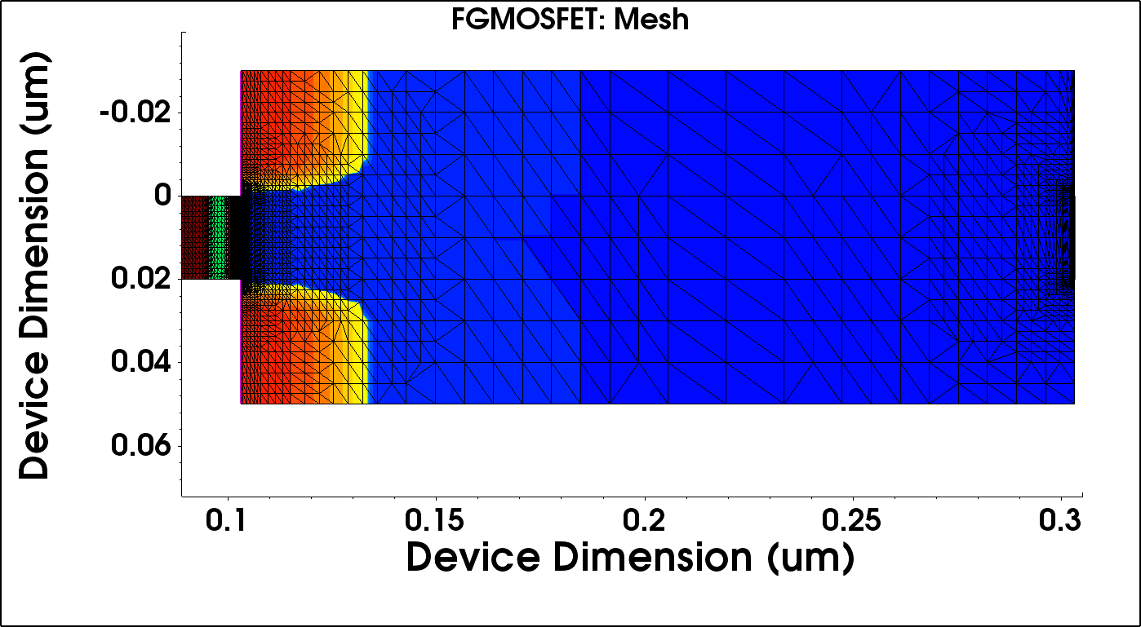

Slide 45
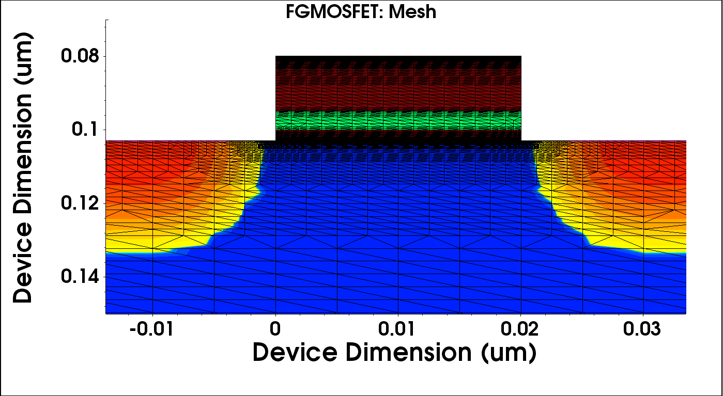

Slide 46
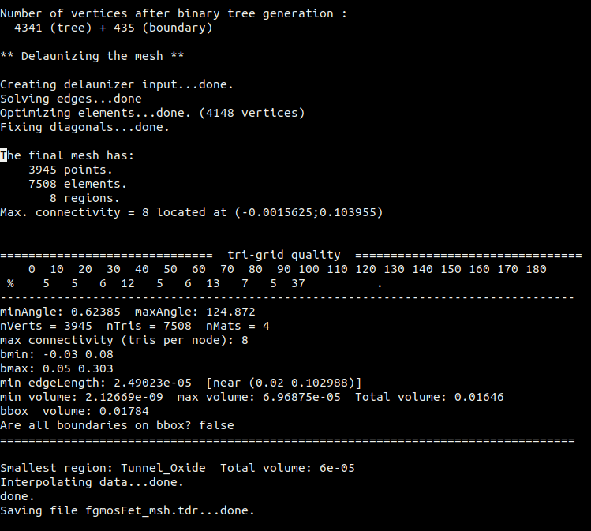
Mesh Information
Total tree vertices = 4341
Total boundary vertices = 435
Final Mesh:
3945 points
7508 elements
8 regions
Notes:
How #points < #tree vertices?????????

Slide 47
5. Sprocess
<one or 2 slides>

Slide 48
Sdevice
Sdevice is a numeric semiconductor device simulator.
It can simulate electrical, thermal and optical properties of semiconductor devices.
The command file consists of 6 sections, which are independent of each other.
File section, Electrode section, Physics section, Plot section, Math section, Solve section.
Extension of the command file : _des.cmd
Notes:
Continuity and Poisson equation
Explain the command file sections
Explain carrier transport models

Slide 49
Add important things like carrier transport models,
Few of command file sections - Will add at last

Slide 50
The input file to sdevice was taken from sde.

Slide 51


Sdevice Script

Slide 52

CV characteristics
Without SRH, iterations =50
Max step=0.05 Increment=1.3
Frequency=10⁶Hz
Notes:
Polydepletion effect

Slide 53

With SRH, iterations =50
Max step=0.05 Increment=1.1
Frequency=10⁶Hz

Slide 54

With SRH, iterations =100
Max step=0.01 Increment=1.1
Frequency=10⁶Hz

Slide 55

Without SRH, iterations =50
Max step=0.05 Increment=1.3
Frequnecy=10⁹Hz

Slide 56

With SRH, iterations =100
Max step=0.01 Increment=1.1
Frequnecy=10⁹Hz

Slide 61
Section - 2
Device Characterization

Slide 62
Table of Contents
Experiment 1: Measurement and Instrumentation
Experiment 2: Diode & Solar Cell Characterization
Experiment 3: Thin Film Thickness Characterization

Slide 63
Experiment 1: Measurement Instrumentation
Tasks:
Characterize a capacitor/inductor using Function Generator and Oscilloscope
Verify Ohm’s law for a resistor by programming a SMU. Ensure that you understand various settings of an SMU and their impact on the measurement.
Devices Used:
RTM 2054 Oscilloscope
Keithley 2636B SMU

Slide 64

Characterising a Capacitor/Inductor
Inductors and Capacitors have a frequency-dependant impedance. This cause a phase shift between the input and output signals to these components.
We can intuitively decide the type of impedance based on the sign of phase difference as:
where θ is phase difference measured using oscilloscope and R is the test resistance. X can either be ⍵_{O}L or 1/⍵_{O}C based on the type of impedance, where ⍵_{O} is the frequency of the input signal.

Slide 65

Procedure
Connect a test resistor of known value across the given black box component.
Apply a sinusoidal voltage and measure the output across the blackbox component using the oscilloscope.
From the voltage waveforms from the oscilloscope, we find the phase difference θ and decide the type of impedance based on the sign of phase difference

Slide 66
Results
For each of the components, we have used 4 different input frequencies.
Test resistors of 268kΩ for capacitor and 2kΩ for inductor were used.
The oscilloscope data was exported and plotted using python.

Slide 67

Figure 1

Slide 68

Figure 2

Slide 69
The phase differences obtained from figure 1 are 38º, 81º, 82º and 89º lagging for ⍵_{O} =1000, 100, 50 and 10 Hz respectively. Hence, we calculate the capacitance to be 1.02nF, 1.04nF, 1.65nF and 0.76nF respectively.
From figure 2, the phase difference is 4º, 35º, 82º and 89.2º leading for ⍵_{O} =10k, 100k, 1M and 10 MHz respectively. Hence, we calculate the inductance to be 2.25mH, 2.23mH, 2.26mH and 2.27mH respectively.

Slide 70
Ohm’s Law verification
We used Keithley 2636B SMU to accurately measure the resistance.
This SMU provides 2 modes of measurement: 2-wire measurement and 4-wire measurement.
Triax cables were used for measurement.
We have tested both ways of measurement and plotted the results.
A TSB software was used to program the SMU with a linear Voltage Sweep and the current values were measured at each voltage level.
The data was exported and plotted using python.

Slide 71

2-wire measurement
The SMU used has the Force line as a signal line and the Sense as a feedback line, which enables the SMU to settle the output voltage at a sensing point.
In two wire measurement, it requires only two test-lead resistance.

Slide 72

4-wire measurement
In four wire measurement, we connect the Sense Hi to Force Hi and Sense low to Force low. Due to high impedance of the voltmeter Vm, the lead resistances can be neglected to get more accurate resistance values (especially for low resistance values).

Slide 73

Ohm’s Law Verification
Rated R=10ohms.

Slide 74
Effect of NPLC value
NPLC stands for Number of Power Line Cycles.
This sets the integration time, which is the time period of the instrument’s ADC to measure the input signal.
The higher value of NPLC corresponds to less AC noise and hence provides better readings.

Slide 75


Slide 77
Experiment 2: Diode and Solar Cell Characterization
Tasks:
Perform IV and CV characterization of a diode with an aim to extract the first order SPICE parameters of a diode.
Characterize the efficiency and maximum power point of a Silicon Solar cell.
Devices Used:
Rhode and Schwarz Oscilloscope
Keithley 2636B SMU
CMU

Slide 78


IV Characteristics
1N4007 diode
Zener Diode
Current (I)
Voltage (V)
Breakdown voltage is 4.3V
The knee voltage is 0.62V.

Slide 79




1N4007 diode CV characteristics
Vpp=2V

Slide 80




Vpp=4V

Slide 81




Vpp=8V

Slide 82





Slide 83

Where τ is the minority carrier lifetime, I is the forward bias current, K is the boltzmann constant and T is the temperature. Putting the I and τ values for 100K frequency, 4Vpp and taking T as 300K, we get Cdiff as 1.7μF

Slide 84



Zener Diode CV Characteristic

Slide 85



Solar Cell CV Characteristics

Slide 86


Responsivity of Solar Cell
There is a significance drop after hc/Eg because the photons don't have energy to excite the e- from VB to CB. For Si, hc/Eg=1.11um for Eg=1.12eV.
Notes:
widely used for cell analysis or calibration purposes.
Decreases when lambda increases as each photon has higher energy

Slide 87
Conclusions - Add in respective slides

Slide 89
Experiment 3: Thin Film Thickness Characterization
Tasks:
Perform spectroscopic reflection measurement on SiO₂ on Si film provided to you and determine the thickness of SiO₂ film.
Tools Used:
Spectrophotometer
Nanohub

Slide 90

Procedure
The sample of unknown thickness is placed in the spectrophotometer and reflectances values are measured by varying the wavelengths at a constant angle.
We can also obtain the thickness by changing the incident angles and keeping wavelength constant.
Curve fitting is used to get the thickness values.
Thickness is also directly related to the refractive index and wavenumber.
Substrate thickness - 500um

Slide 91


Sample 1
Reflectance vs. wavelength at 45 degree incident angle.
Reflectance vs. wavelength at 30 degree incident angle.
Wavelength in nm

Slide 92


Mean Square Error at different thickness
45 degree incident angle.
30 degree incident angle.
MSE is the least at 90nm in both the cases.
Hence, the thickness is 90nm.

Slide 93


Sample 2
Reflectance vs. wavelength at 45 degree incident angle.
Reflectance vs. wavelength at 30 degree incident angle.
Wavelength in nm

Slide 94


Mean Square Error at different thickness
45 degree incident angle.
30 degree incident angle.
MSE is the least at 890nm in both cases.
Hence, the thickness is 890nm.

Slide 95

Second method of calculating thickness (On Sample 2)
Using the formula, we get d as 745nm.

Slide 96

GaAs Band Gap Measurement
Wavelength in nm
There is an increase of transmittance at 900nm. Therefore, estimated bandgap is 1.39eV.

